Slide 1

ADR’s to the rescue
Notes:
ADR’s to the rescue
Architecture Decision Records
Photo by <a href="https://unsplash.com/@yuliamatvienko?utm_source=unsplash&utm_medium=referral&utm_content=creditCopyText">Yulia Matvienko</a> on <a href="https://unsplash.com/photos/kgz9vsP5JCU?utm_source=unsplash&utm_medium=referral&utm_content=creditCopyText">Unsplash</a>

Slide 2
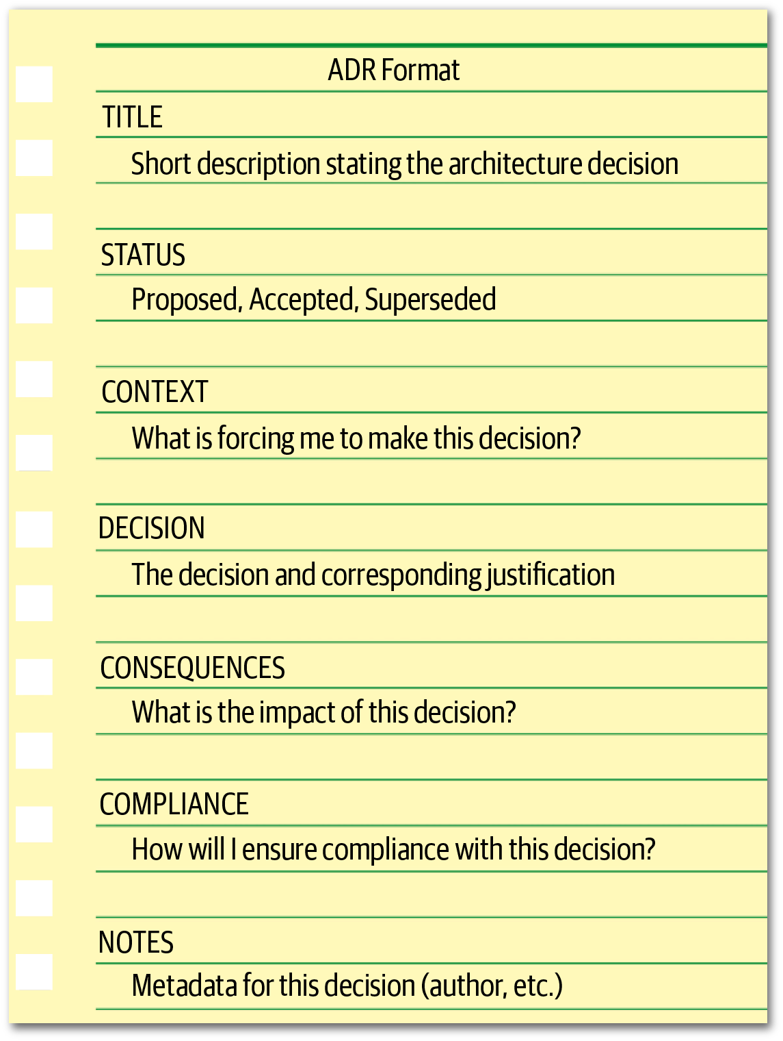

Slide 3
